Slide 1
Circlize Package
Making Circular Charts

Slide 2
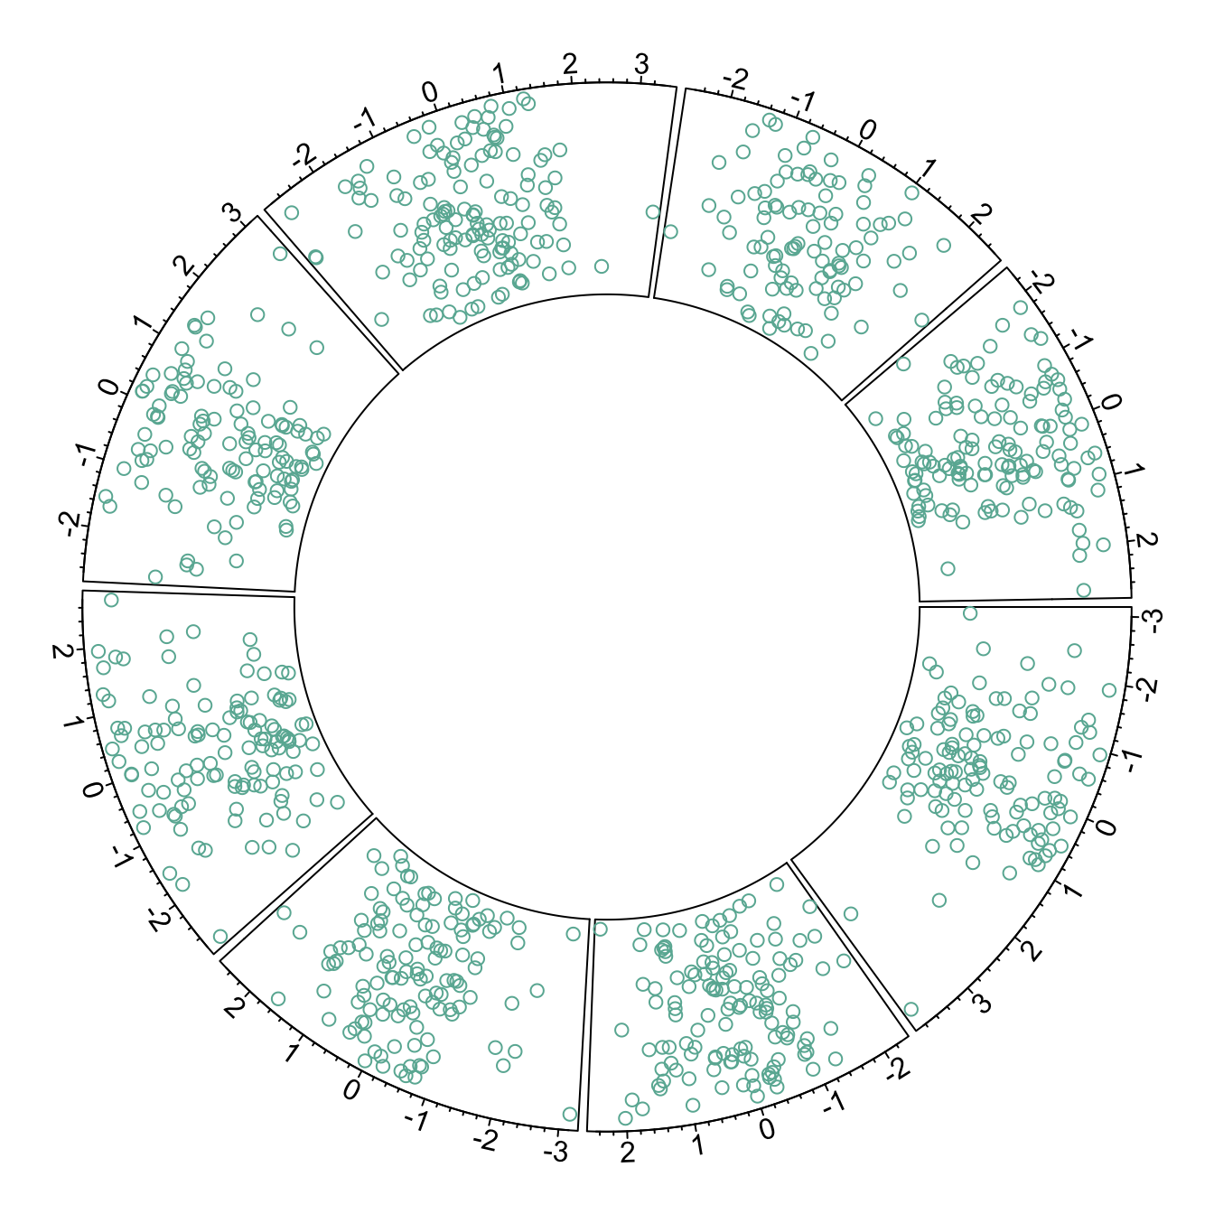
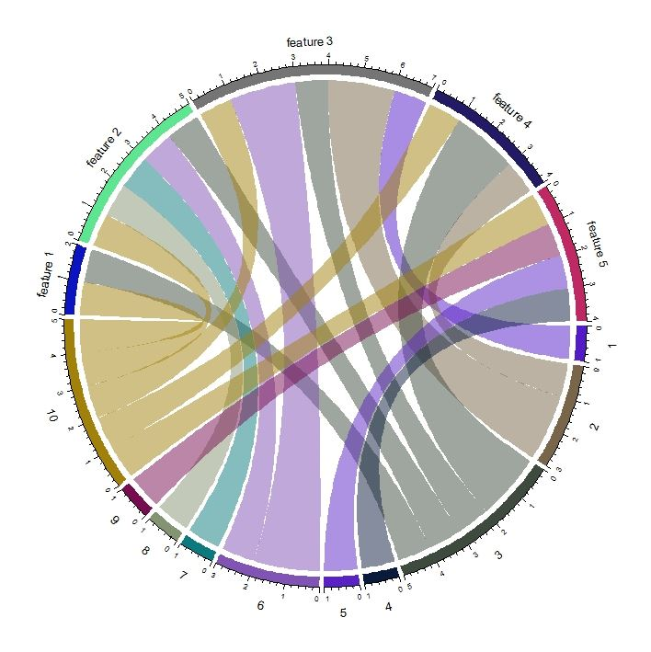
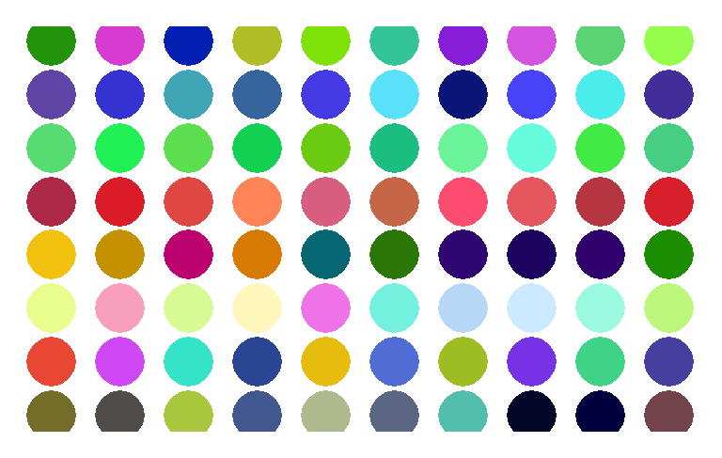
What it does
Create Circular Charts
Helps show structure
Visually pleasing – easier to see without specific values
Chord Diagrams
Shows flow
Allows another layer of information to be added
Make Several Charts in the Same Window
Facet data
Show things visually

Slide 3
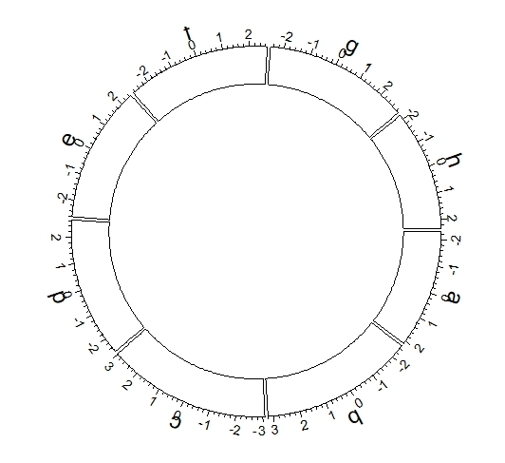
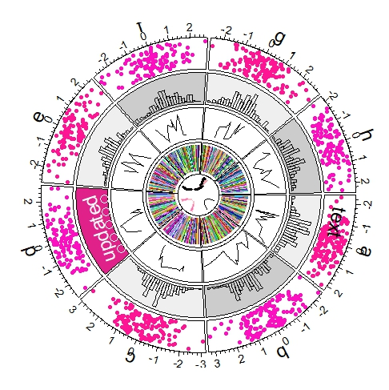
How it Works
Initialize chart
Set how many segments you want
circos.initialize(data$sectors, x = data$x)
Amount/length of sectors determined by the data
Build Regions
circos.trackPlotRegion
circos.trackPlotRegion(factors = data$factor, y = data$y, panel.fun = function(x, y) {circos.axis()})
Add a Chart in each Region
Can do bar charts, scatter plots, etc
Ex for scatter plot: circos.trackPoints()
Keep Adding Layers
Clear Cell
Circos.clear
Makes cell ready to graph something new

Slide 4
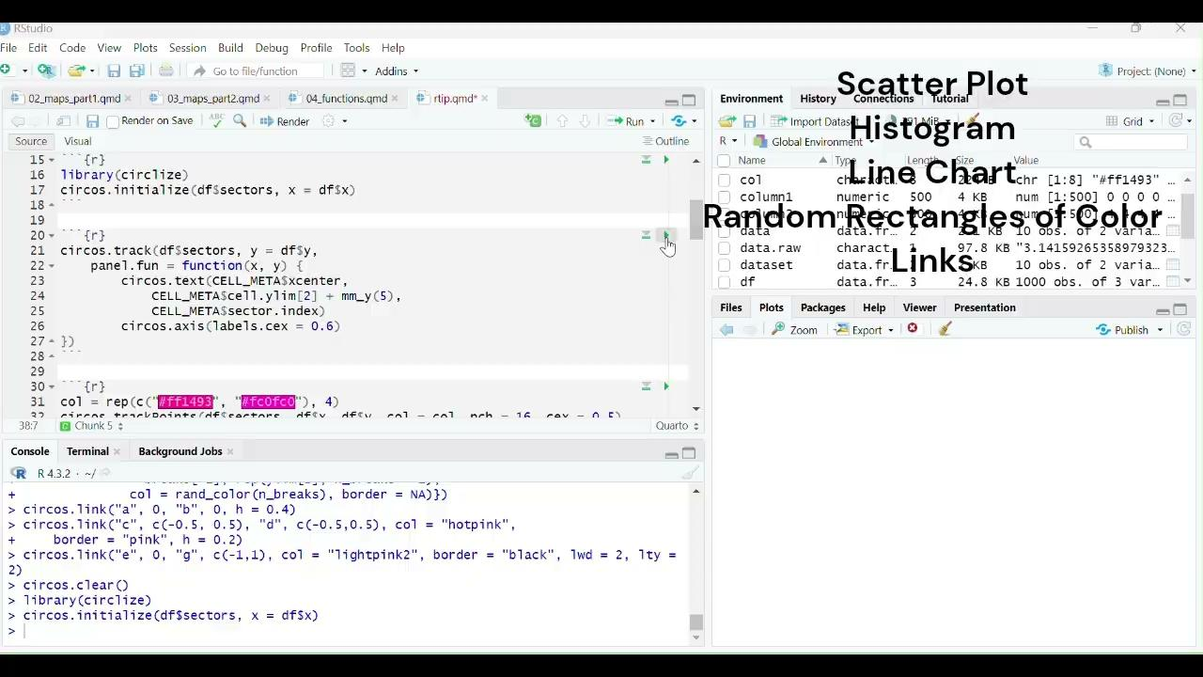
Stacking Tracks & Customization
Repeat Building Regions
Customize width of tracks with track.height
Three Levels of Customization
Initialization
Uses par() and circos.par()
Axis
Uses circos.axis()
Chart Shapes
circos.trackPoints()
Updating Single Section
circos.update()

Slide 5
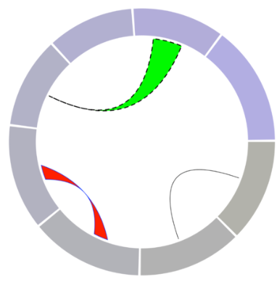
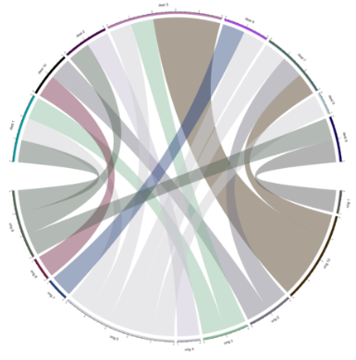
Making Connections
Link sections to show connections
circos.link()
Manual
Adds connections one-by-one
chordDiagram()
Plots the whole dataset at once
circos.link()
chordDiagram()

Slide 6
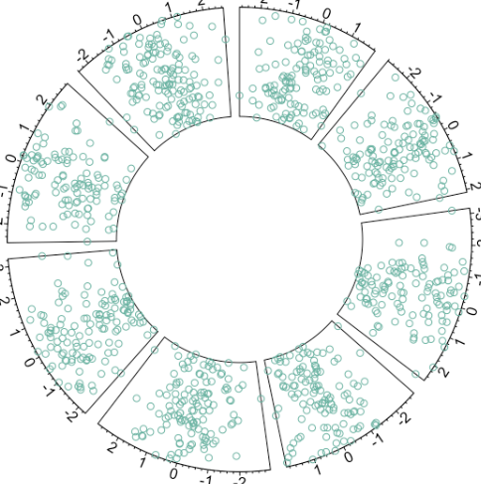
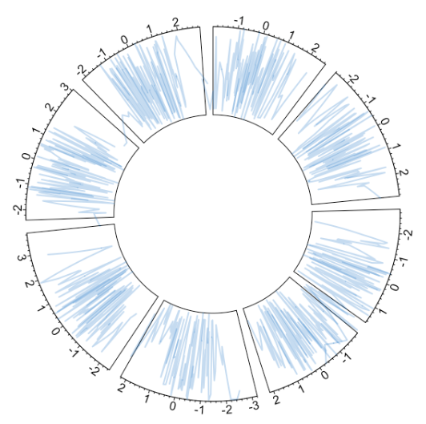
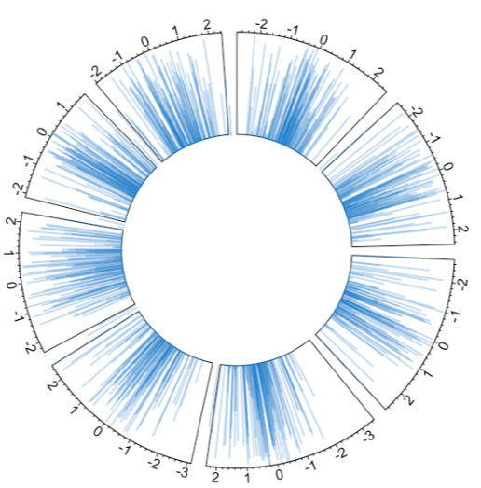
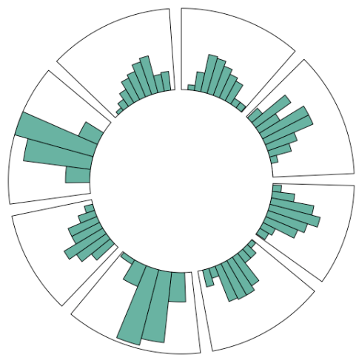
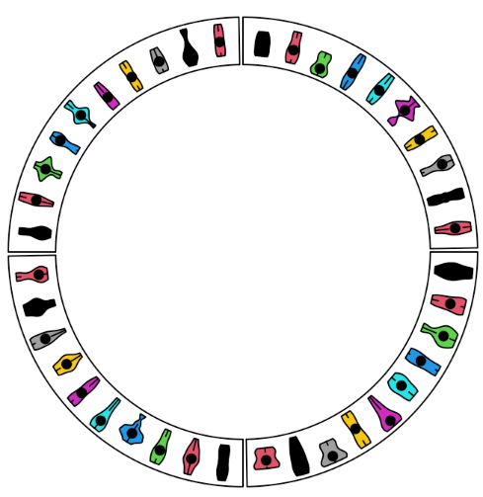
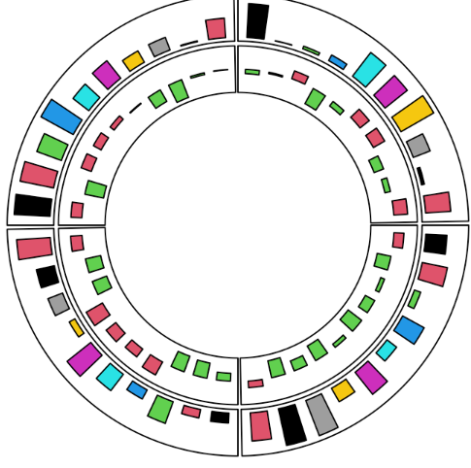
Types of Charts
Scatterplots
Line Charts
Vertical Ablines
Histograms
Barplots/Boxplots/Violin Plots

Slide 7
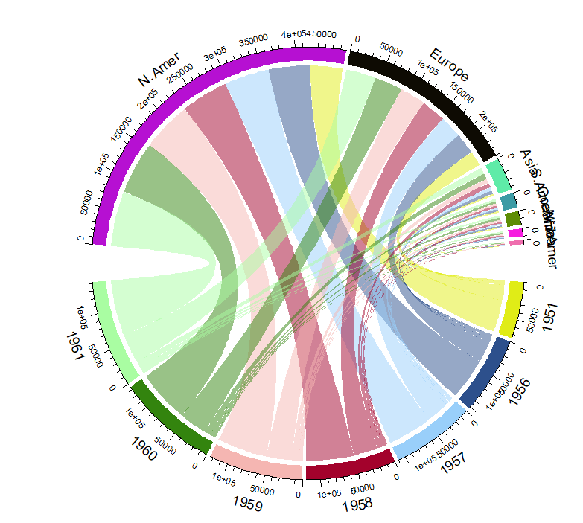
Example
Dataset: WorldPhones – contains information about the amount of phones in different regions of the world over several years
Code:
library(circlize) ← loads the circlize library
data("WorldPhones") ← loads the data package that we will be using
chordDiagram(WorldPhones, transparency = 0.5) ←makes a chord diagram showing the relationship between the amount of phones and years in different regions. The transparency makes the chords a bit translucent to help fully show all of the connections

Slide 8
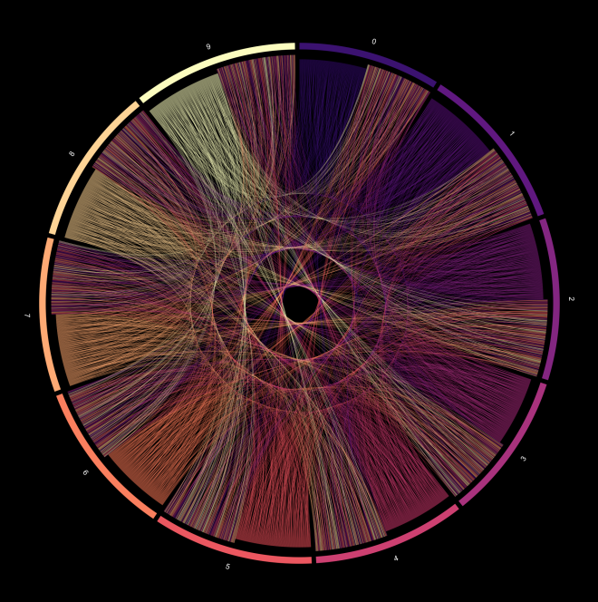
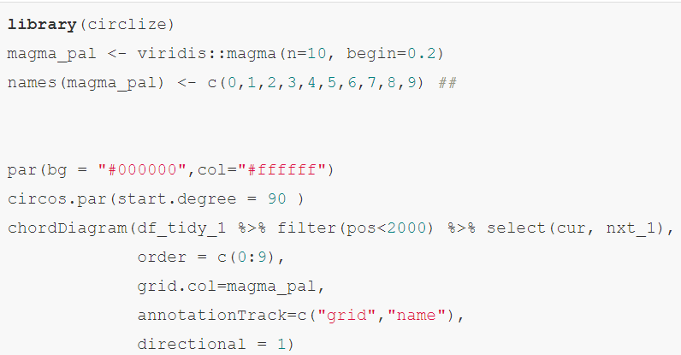
Pi Illustration
Representation of the first 100,000 digits of pi
Chords show where the numbers are found together
CHI'S IMPE[R]FECT BLOG

Slide 9
Sources
Blog, R. on Chi’s Impefect. Visual Art with Pi Using Ggplot2 & Circlize | R-Bloggers. 13 Oct. 2018, https://www.r-bloggers.com/2018/10/visual-art-with-pi-using-ggplot2-circlize/.
Gu, Zuguang. Circular Visualization in R. jokergoo.github.io, https://bookdown.org/jokergoo/circlize-book/book. Accessed 3 Mar. 2024.
Holtz, Yan. Introduction to the Circlize Package. https://www.r-graph-gallery.com/224-basic-circular-plot.html. Accessed 3 Mar. 2024.

